Slide 1
Module-6 Alternative Paradigms: Scripting Languages
Common characteristics
Different Problem domains for using scripting,
Use of scripting in Web development–server and clients side scripting,
Innovative features of scripting languages - Names and Scopes, string and pattern manipulation, data types,
object orientation.
Presented By-
Seema Jadhav

Slide 2
Scripting Languages
A script or scripting language is a computer language that does not need the compilation step and is rather interpreted one by one at runtime.
It is where the script is written and where instructions for a run-time environment are written.
In contrast to programming languages that are compiled first before running, scripting languages do not compile the file and execute the file without being compiled.

Slide 3
Scripting Language
A scripting language is a computer programming language that provides instructions, called scripts, for software in apps and websites.
Scripts contain a series of commands that a software, application or scripting engine interprets one at a time within a runtime environment.
During runtime, the interpreter converts these instructions into readable machine code that a processor can execute.

Slide 4
Examples of Scripting Languages
bash: It is a scripting language to work in the Linux interface. It is a lot easier to use bash to create scripts than other programming languages. It describes the tools to use and code in the command line and create useful reusable scripts and conserve documentation for other people to work with.
Node js: It is a framework to write network applications using JavaScript. Corporate users of Node.js include IBM, LinkedIn, Microsoft, Netflix, PayPal, Yahoo for real-time web applications.
Ruby: There are a lot of reasons to learn Ruby programming language. Ruby’s flexibility has allowed developers to create innovative software. It is a scripting language which is great for web development.
Python: It is easy, free and open source. It supports procedure-oriented programming and object-oriented programming. Python is an interpreted language with dynamic semantics and huge lines of code are scripted and is currently the most hyped language among developers.
Perl: A scripting language with innovative features to make it different and popular. Found on all windows and Linux servers. It helps in text manipulation tasks. High traffic websites that use Perl extensively include priceline.com, IMDB.

Slide 5
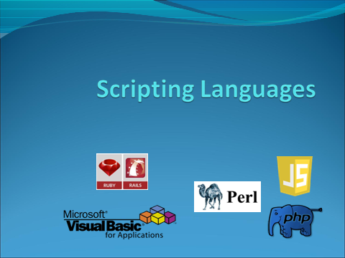

Slide 6
Advantages Scripting Languages
Easy learning: In order to learn scripting languages, there is not much need for the knowledge of web technology. Therefore, these languages enable users to learn code quickly.
Fast editing: It is particularly efficient since it uses a small amount of data structures and variables.
Interactivity: It helps to make web pages more interactive by adding combinations and visualization interfaces. The use of scripting languages is demanded by modern web pages. It includes background and foreground colors and so on, which helps to create enhanced web pages.
Functionality: Scripting languages contain different libraries, which help to create new applications in web browsers. They are different from normal programming languages.

Slide 7
Uses Of Scripting Languages
Task automation
Content display for web applications
Command sequences
Data extraction
System administration
Dynamic web apps

Slide 8
Common Characteristics:
Both batch and interactive use-
While a few languages (e.g. Perl) have a compiler that requires the entire source program, almost all scripting languages either compile or interpret line by line.
Many “compiled” versions are actually completely equivalent to the interpreter running behind the scenes (like in Python).
Economy of expression-
eliminating any unnecessary phrasing from your writing.
Two variants: some make heavy use of punctuation and short identifiers (like Perl), while others emphasize “English-like” functionality allowing lots of words & not a lot of punctuation.
Class Demo print “Hello World\n”
{
Public static void main(String args[])
{
System.out.println(“Hello World”);
}}

Slide 9
Lack of declarations; simple scoping rules.
While the rules vary, they are generally fairly simple and additional syntax is necessary to alter them.
In Perl, everything is of global scope by default, but optional parameters can limit the scope to local.
In PHP, everything is local by default, and any global variables must be explicitly imported.
In Python, everything is local to the block in which the assignment appears, and special syntax is required to assign a variable in a surrounding scope.
Flexible dynamic typing
In PHP, Python and Ruby, the type of a variable is only checked right before use
In Perl, Rexx, or Tcl, things are even more dynamic:
$a = “4”
print $a . 3 . “\n” (.indicate Concatenation)
print $a + 3 . “\n” (+ indicate Addition)
Outputs the following:
43
7

Slide 10
Easy access to other programs
While all languages provide support for OS functionality, scripting languages generally provide amazing and much more fundamental built-in support.
Examples include directory and file manipulation, I/O modules, sockets, database access, password and authentication support, and network communications.
Sophisticated pattern matching and string manipulation
Perl is perhaps the master of this, but it traces back to the text processing sed/awk ancestry.
These are generally based on extended regular expression (which we already saw a bit of when using lex at the beginning).

Slide 11
High level data types
In general, scripting languages provide support for sets, dictionaries, lists and tuples (at a minimum).
While languages like C++ and Java have these, they usually need to be imported separately.
Behind the scenes, optimizations like arrays indexed using hash tables are quite common.
Garbage collection is always automatic, so user never has to deal with heap/stack issues.

Slide 12
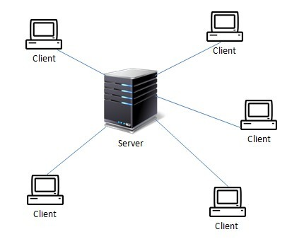
Client – Server
On a network, the client computer can be considered as a user computer connected to the server.
A server is a computer which provides some kind of resource to client computers.

Slide 13
Client Side Scripting
Client-side scripting typically works in the front end, with script visible to users.
It can help reduce server load and is often used to change content or examine users' forms for mistakes before submitting them.
Common client-side scripting languages include:
jQuery: jQuery is a JavaScript library designed to simplify event handling, animation, and working with HTML.
CSS: A language that helps you design graphic elements to enhance web applications' appearance
JavaScript: A language that creates highly functional modern web browsers, including Mozilla's SpiderMonkey and Chrome's V8 engine.

Slide 14
Examples:
Visual Basic for Applications (VBA) is a scripting language for Microsoft programs such as Word, Excel and Access
JavaScript is a client-side scripting language which can be used to develop scripts for web pages
PHP is a server-side scripting language used to create dynamic web pages

Slide 15
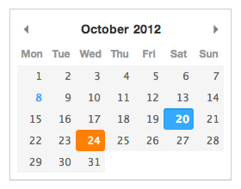
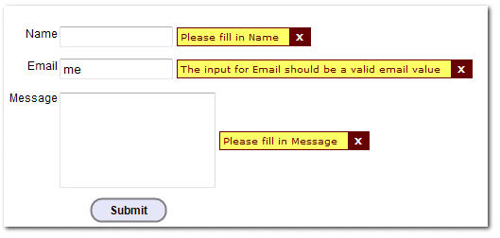
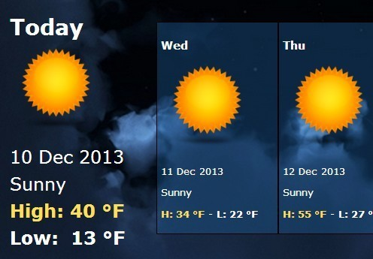
JavaScript is a good example of a client-side scripting language for a web page. It can be used to develop interactivity on a web page e.g.
calculator
clock
input validation of text field
The client-side script is embedded within the web page HTML but is run by the client computer via the browser.

Slide 16
Server-side scripting
Server side scripting means that all of the code is executed on the server before the data is passed to the user's browser.
The result returned to the client will typically be in HTML created “on the fly” by the server script. In other words, a dynamic web page.

Slide 17
Server Side Scripting
Server-side scripting works in the back end—what happens behind the scenes that website users don't see but makes it possible for them to use the site. You can customize web pages and create dynamic websites with these scripting languages.
Common server-side scripting languages include:
PHP: Popular for use on the web
ASP.net: A web application language that Microsoft developed
Node.js: A scripting language you can use on multiple platforms including Unix, Windows, Mac, and Linux
Ruby: A dynamic scripting language that focuses on simplicity
Python: A popular language that uses shorter code, making it easier for beginners to learn

Slide 18
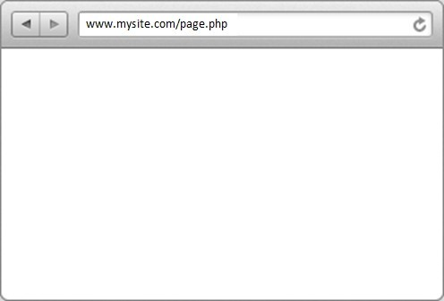


Server-side scripting
Step 1 – client requests a web page

Slide 19
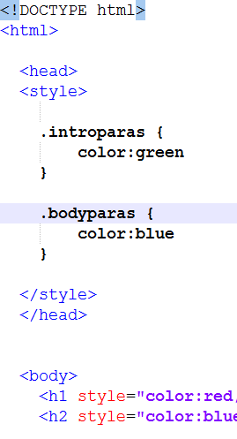
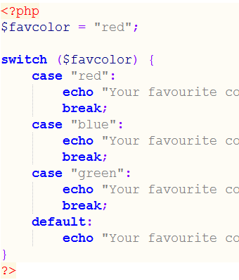

Server-side scripting
Step 2 – server executes the script, producing dynamic HTML output

Slide 20


Server-side scripting
Step 3 – server returns dynamic HTML page to browser

Slide 21
Server side scripts:
return pages specific to the user e.g. social media feed, e-commerce recommendations etc.
Client side scripts:
will be returned in the dynamic page to allow interactions such as zooming images, clicking option buttons etc.

Slide 22
CLIENT SIDE SCRIPTING | SERVER SIDE SCRIPTING
Source code is visible to user. | Source code is not visible to user because it’s output of server side is a HTML page.
It usually depends on browser and it’s version. | In this any server side technology can be use and it does not depend on client.
It runs on user’s computer.(Web Browser) | It runs on web server.
There are many advantages link with this like faster. response times, a more interactive application. | The primary advantage is it’s ability to highly customize, response requirements, access rights based on user.
It does not provide security for data. | It provides more security for data.
It is a technique use in web development in which scripts runs on clients browser. | It is a technique that uses scripts on web server to produce a response that is customized for each clients request.
HTML, CSS and javascript are used. | PHP, Python, Java, Ruby are used.

Slide 23
Parameters | Scripting Language | Programming Language
Language Type | The scripting languages are interpreter-based languages. | The programming languages are compiler-based languages.
Use | The scripting languages help in combining the existing components of an application. | The programming languages help in developing anything from scratch.
Running of Language | A user needs to run scripting languages inside an existing program. Thus, it’s program-dependent. | Programming languages are program-independent.
Conversion | Scripting languages convert high-level instructions into machine language. | Programming languages help in converting the full program into the machine language (at once).
Compilation | You don’t need to compile these languages. | These languages first need a compilation.
Design | These make the coding process simple and fast. | These provide full usage of the languages.
File Type | Scripting languages don’t create any file types. | Programming languages create .exe files.
Complexity | These are very easy to use and easy to write. | These are pretty complex in terms of writing and usage.
Type of Coding | Scripting languages help write a small piece of an entire code. | Programming languages help write the full code concerning a program.

Slide 24
Developing Time | These take less time because they involve lesser code. | These take more time because a programmer must write the entire code.
Interpretation | We usually interpret a scripting language in another program. | The compile results of a programming language are stand-alone. No other program needs to interpret it.
Requirement of Host | Scripting languages require hosts for execution. | Programming languages are self-executable. They don’t require any host.
Length of Codes | These involve very few and short coding lines. | These require numerous lines of coding for a single function.
Support | These provide limited support to data types, user interface design, and graphic design. | These provide rich support for graphic design, data types, and user interface design.
Maintenance | These involve very low maintenance. | These involve high maintenance.
Cost | It is easier and cheaper to maintain a scripting language. | Maintaining a programming language is comparatively more expensive.
Example | VB Script, Perl, Ruby, PHP, JavaScript, etc. | C, C++, COBOL, Basic, VB, C#, Pascal, Java, etc.

Slide 25
Example of Java Script
<!DOCTYPE html>
<html >
<head>
<title>
Basic Example to Describe JavaScript
</title>
</head>
<body>
<script>
console.log(“Hello World”);
</script>
</body>
</html>

Slide 26
Thank You

